Slide 1

More about the presentations
Make sure to follow these guidelines:
Just don’t regurgitate what you’ve read – ADD YOUR IDEAS and RESEARCH (include references at end)
Include images/graphics that support your message
Try not to read your slides verbatim
Include a “take away” on the slides
What I found interesting was…
What you should remember is…
I am not sure I agree with these findings because…

Slide 2
More about the presentations
Broaden Understanding of Engineering
Review Engineering Grand Challenges
Consider societal challenges in engineering
Focus on big picture topics
Taking the long view: Job versus Career
Only make slides on topics in the assignment
Do background research as needed to create informative presentation
Just don’t regurgitate what you’ve read–ADD YOUR IDEAS and RESEARCH (include references at end)
Include images/graphics that support your message
Try not to read your slides verbatim
Include a “take away” on the slides
What I found interesting was…
What you should remember is…
I am not sure I agree with these findings because…
Focus on big ideas
Not too wordy, don’t read slides
Use images to back up presentation
Include “Take Away” - Critical to design sustainability in from the beginning
Presentation clarity
Concise analysis of summary conclusions
Concise statement of why the material is important (societal and/or technical concerns/needs addressed
Presentation time management
The individual student presentation slides must be integrated with the rest of the team.
aim for 20 min. DO NOT GO OUT OF 16-22 RANGE
10 slides, plus cover and citation (syllabus)
16-20 slides (presentation)
90 is A, need a 95 to not need to show up any more lol
title slide:Group #, Title (Topic), Team Names
power point!
1. Familiarity with grand technology and societal challenges facing today’s engineers.
2. Awareness on topics beyond traditional technical course content and of significant interest for Engineering Careers.
3. Understand and present summaries of technology/societal topics (public speaking skills).

Slide 3
Presentations divvy up
Hayden
General context
Issue because: Global Warming, …
GHG, 33% is transportation (page 17)
Looking towards the future, we need to do X by YYYY (100% by 2035? Disagree (page 18))
https://drawdown.org/sectors/transportation
Mitchell
Global challenges
How does this affect other countries?
How are other countries dealing with this?
https://www.citiesforum.org/news/superblock-superilla-barcelona-a-city-redefined/
Keenan
Plans and strategies, what’s being done
Effects of covid on transportation (no long term effect) (page 30 / page 31 / page 35)
Policy
Walking biking
Electrify
Andrew
Future plans and strategies
Zero emission vehicles (pg 53)
Batteries (EV)
Sustainable fuel supplies / Where does electricity come from to power our EVs?
Rail and Maritime transportation
Hayden
What we’ve learned today
Five principles

Slide 4
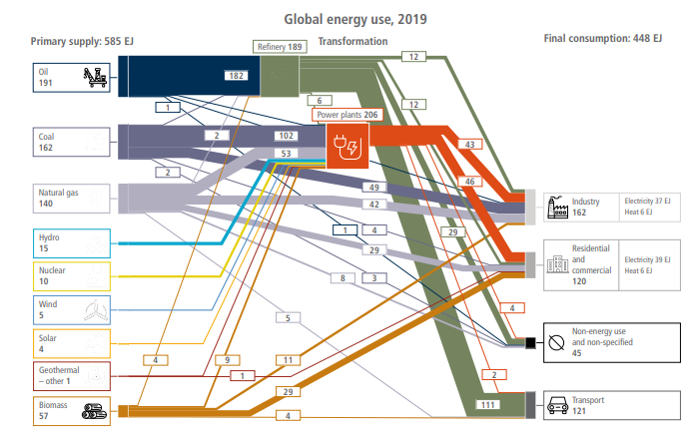
Notes
In the paper, a solution section starts on page 38

Slide 5
MEETING LINK
https://rensselaer.webex.com/rensselaer/j.php?MTID=mb1bf9b33d273e0a07f21adbd264ff73f

Slide 6
EERE Decarbonization Transportation Report 508
ECSE 2900
January 16, 2024
Members: Andrew Bank, Hayden Fuller, Keenan Schilp, Mitchell Long
Notes:
Hello everybody, I’m Hayden, *Introductions…*: and this is our presentation on the office of Energy Efficiency and Renewable Energy Decarbonization of Transportation Report

Slide 7
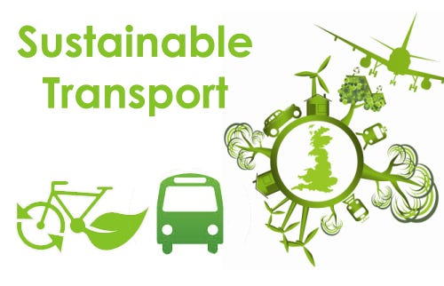

What we’re Discussing Today (Hayden)
Transportation’s contribution to global warming (and more)
Plans, strategies, and what’s being done
What more needs to be done
Notes:
So, today our discussion will include how our current transportation system contributes to global warming, some of its other issues, what’s currently being done to address these issues, and what more needs to be done in the future

Slide 8
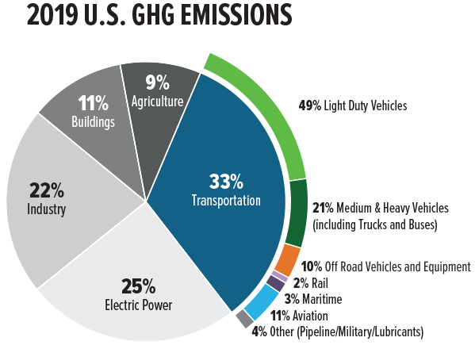
Why do we care about Transportation Emissions (Hayden)
Global Warming, GreenHouse Gasses (GHG) are the main contributor
Transportation accounts for 33% of GHG emissions
Better air quality, healthier environment
Quieter, safer, more equitable, walkable and bikeable cities
Notes:
So, to start, why should you care about any of this? Well firstly there’s global warming- you’re all pretty smart, I trust I don’t have to explain how emissions cause global warming or why that’s an issue or anything, but what you may not know, is that in the US, transportation alone accounts for 33% of all Greenhouse gas emissions, making it the largest contributor by a ,pretty large margin.
But these greenhouse gas emissions aren’t only an issue for our environment in the long term , they’re an issue for the people of today as well, it’s one of a few ways our current transportation system really hurts everyone around it, but thankfully, many emission solutions manage to solve several of these other issues as well.

Slide 9
How does this Affect Other Countries? (Mitchell)
EU - 15% from automobiles

Slide 10
How are Other Countries Dealing with this? (Mitchell)
EU - 100% reduction of automobile pollution by 2035

Slide 11
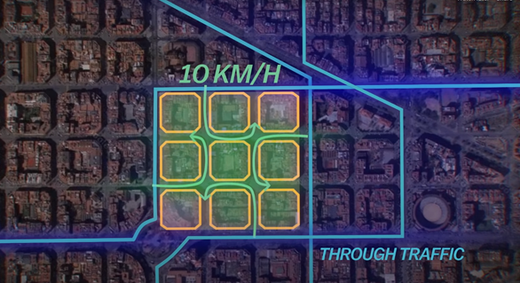
How are Other Countries Dealing with this? (Mitchell)
2013 - 2018 Urban Mobility Plan of Barcelona
400m x 400m blocks
Reduce driving

Slide 12
Challenge
Improving urban mobility
Notes:
Corresponding References: Carnegie Mellon Researches Ways to Mix Touch with VR | Immersive Technology (immersive-technology.com)
NAE Website - NAE Grand Challenges for Engineering
https://www.army.mil/article/34030/virtual_reality_helps_soldiers_deal_with_real_world_burn_pain
https://www.forbes.com/health/mind/virtual-reality-therapy/
https://www.newyorker.com/tech/annals-of-technology/virtual-reality-avatar-speaking

Slide 13
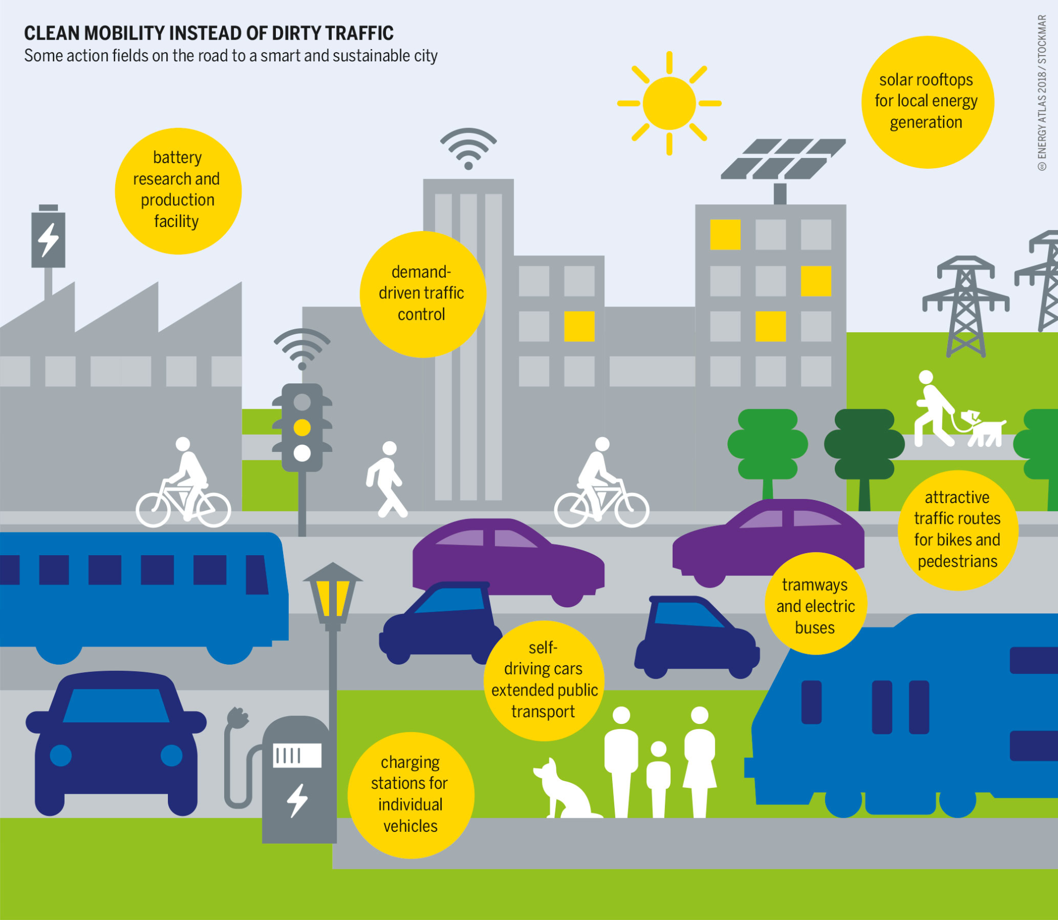
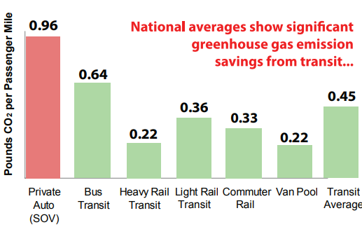
Public Transit (Keenan)
Notes:
Personal Vehicles account for 57 percent of all transportation greenhouse gas emissions
Buses and trains can reduce greenhouse gas (GHG) emissions by up to two-thirds per passenger, per kilometer compared to private vehicles.
Estimates say that global public transport capacity must double by 2030 if the world is to limit global warming to 1.5 degrees C (2.7 degrees F) and avert the worst impacts of climate change.
National averages demonstrate that public transportation produces significantly lower greenhouse gas emissions per passenger mile than private vehicles (see Figure 2).1 Leading the way is heavy rail transit, such as subways and metros, which produce 76% less in greenhouse gas emissions per passenger mile than an average single-occupancy vehicle (SOV). Light rail systems produce 62% less and bus transit produces 33% less
If just one driver per household switched to taking public transportation for a daily commute of 10 miles each way, this would save 4,627 pounds of carbon dioxide per household per year—equivalent to an 8.1% reduction in the annual carbon footprint of a typical American household

Slide 14
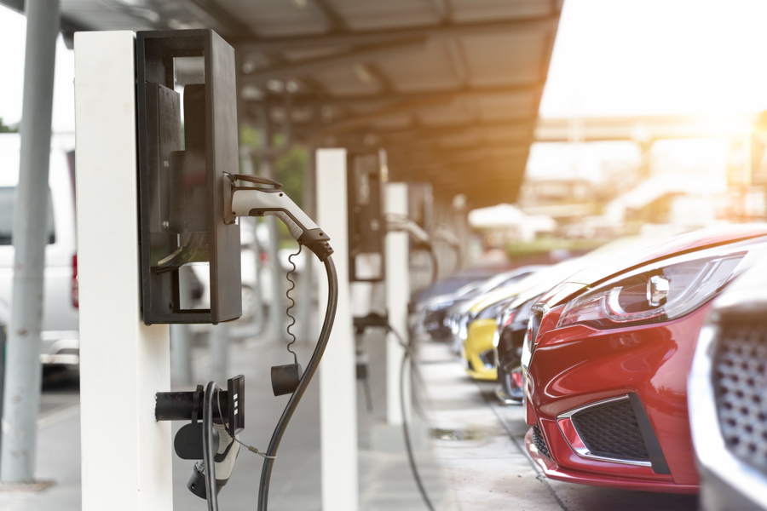
Personal Vehicles in Urban Areas (Keenan)
Notes:
Electric vehicles are the future of clean personal vehicle use in cities.
By embracing the electrification of transportation, cities can reap numerous benefits beyond reduced emissions. Electric vehicles can improve air quality, reduce noise pollution, and enhance energy independence.
The tailpipe emissions from internal combustion engine vehicles cause air pollution, which leads to adverse health impacts. These impacts are predominant in urban areas, which encompass most areas designated to be in nonattainment with Federal air quality standards. Urban residents experience significantly more unhealthy air-quality days than rural residents, including about 12 times more excessive ozone days and 12 times more excessive PM2.5 days per year. Battery electric vehicles run with zero tailpipe emissions,
Urban areas have an average background noise level of 60 decibels, with regular spikes up to 85 decibels or more, and the two largest sources of this environmental noise are transportation and industrial activity.
EVs have significantly lower GHG emissions, especially if electricity is generated with renewable energy sources like hydroelectric, solar, or wind.
In contrast to an internal combustion engine vehicle, EVs, including BEBs and ESBs, can be virtually inaudible due to a lack of engine noise

Slide 15
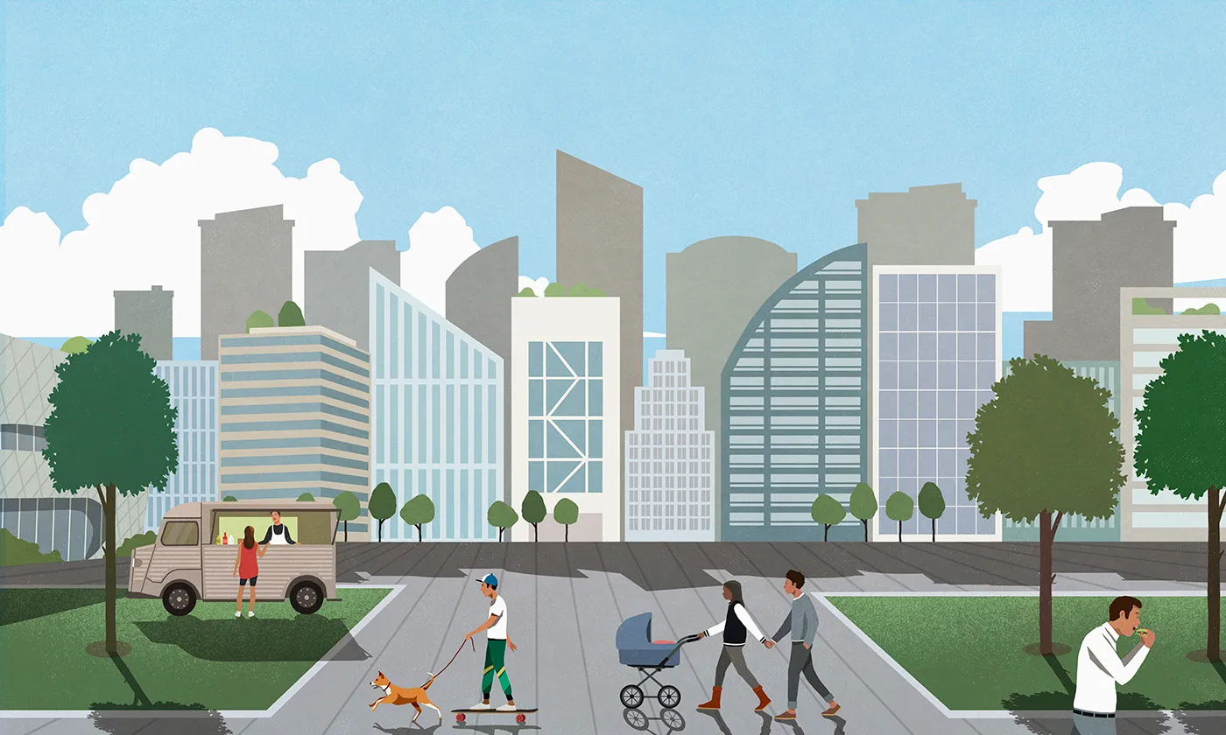
Walk and Bike-friendly Infrastructure (Keenan)
Notes:
Homes, workplaces, and services are often
located far apart from one another. When people
have limited transportation choices, or less
accessible and efficient options, it can take them
even more time to address their daily needs.
The spatial mismatch between jobs, housing,
and services is especially pronounced in
disadvantaged communities.
Not only can we redesign the way we transport ourselves in cities to reduct greenhouse gas emissions, we can also redesign our cities to make them even more sustainable. To do this, we can build more walkable and bike-friendly cities. A walkable environment reduces greenhouse gas emissions by 4 tons a year, compared to living in an automobile-dependent suburb.
As well as reducing greenhouse gas emissions, walkable cities reduce the urban heat island effect by adding shaded, plant-lined sidewalks instead of heat-absorbing asphalt.
Walkable cities also reduce air pollution by cutting tailpipe emissions to zero and reduce background noise with no engine.

Slide 16
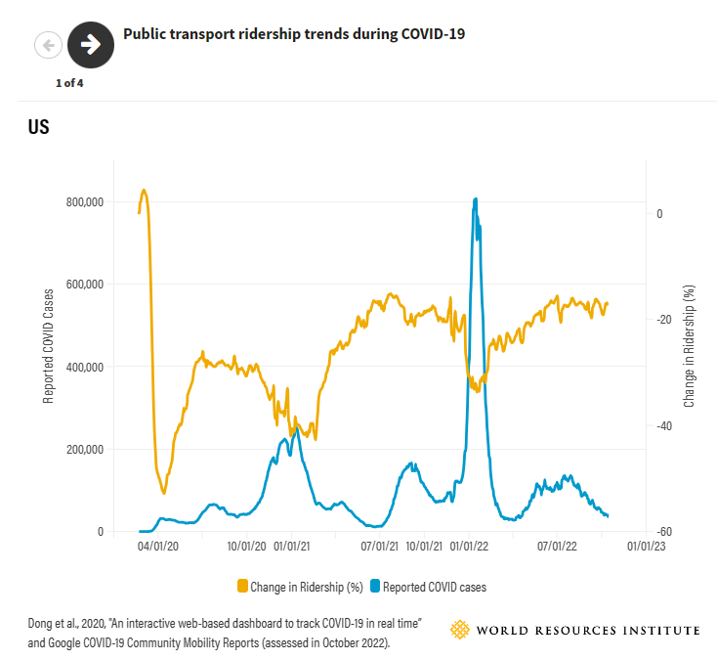
Effects of COVID on Transportation (Keenan)
Notes:
Public transport ridership plummeted during the COVID-19 pandemic, falling by as much as 90% in some cities. Since then it has rebounded to at or near pre-pandemic levels in certain places. Full recoveries were most common in low- and middle-income countries such as Indonesia, Mexico and South Africa, where a significant percentage of the population relies on public transport to access daily necessities. Some countries, including Colombia, Kenya and India, even saw ridership surpass pre-pandemic levels.
But the recovery has been much slower in high-income countries across North and South America and Europe. Some, such as Canada, Japan, Sweden and the United Kingdom, continue to see ridership levels below what they were in February 2020 before the height of the COVID-19 pandemic.
To be able to meet climate goals, we need to prioritize both the upgrade of the infrastructure of public transportation and the marketing around it. We can’t reduce carbon emissions if no one wants to use public transit. Cities around the world are employing ad campaigns as well as implementing cosmetic updates to urban transportation infrastructure to make it more enticing for both residents and visitors of cities.

Slide 17
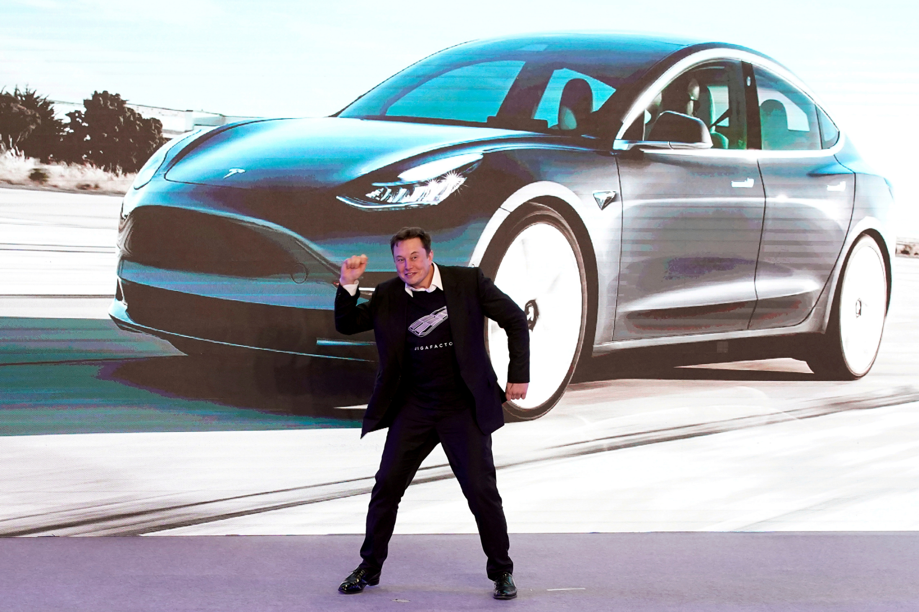
Zero Emission Vehicles (Andrew)
Goal: 50% new vehicles by 2030
Hydrogen fuel cell for heavy vehicles
Personal cars replaced by EVs
Battery improvement
$100 per kWh goal
$137 per kWh current Li
$200 per kWh current Na
Notes:
Sustainable fuel example: biomass and waste feedstock https://www.greencarcongress.com/2023/06/20230615-eia.html
Battery link: https://www.mdpi.com/2313-0105/5/1/10

Slide 18
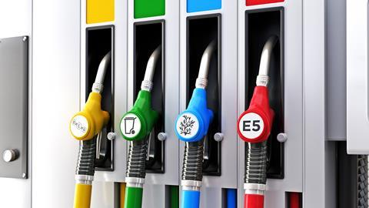
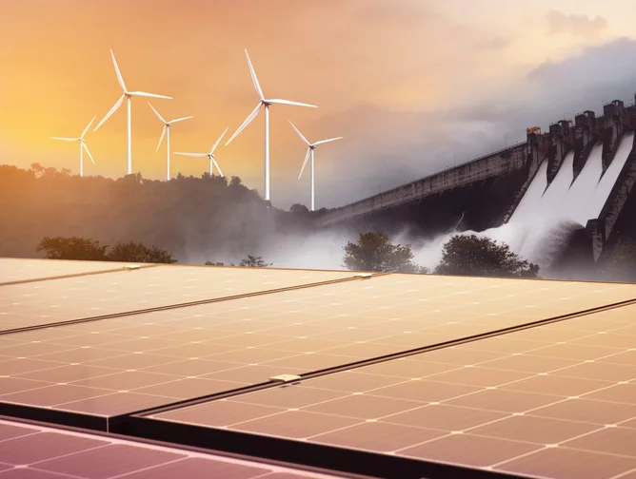

Sustainable Energy Supplies (Andrew)
Sustainable fuels
Biofuel
Hydrogen
Synthetic fuels (aka e-fuels)
Ammonia
Sustainable electricity
Notes:
https://www.ipcc.ch/report/ar6/wg3/downloads/report/IPCC_AR6_WGIII_FullReport.pdf
https://www.futurebridge.com/industry/perspectives-mobility/synthetic-fuels-can-this-be-the-magic-bullet-environmentalists-wanted/

Slide 19
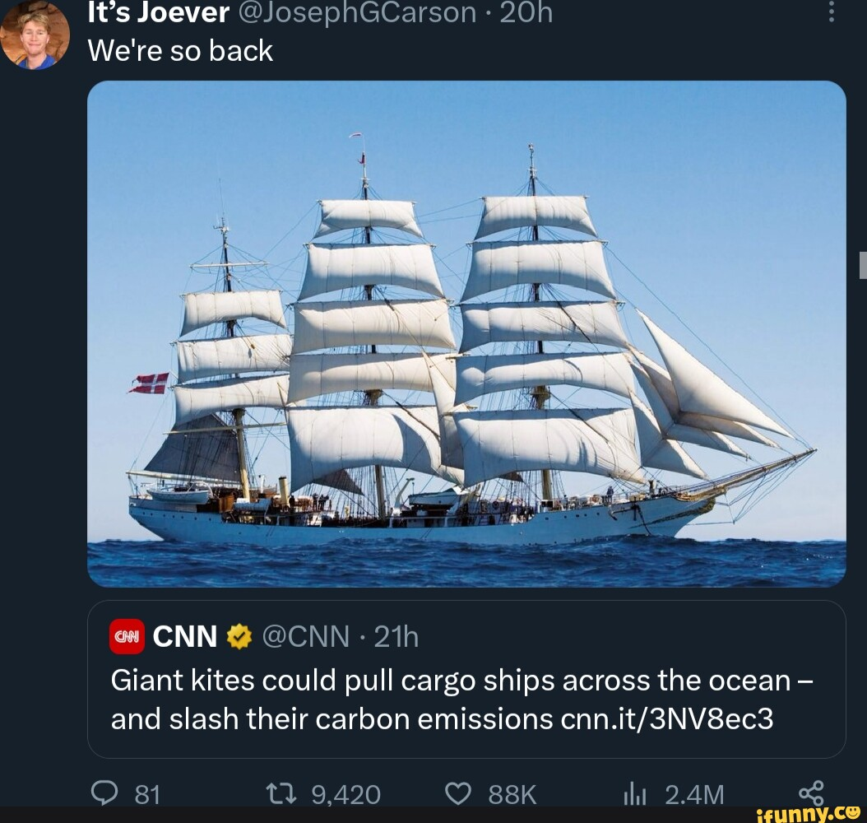

Rail, Maritime, and Aviation (Andrew)
5% of sea fleet 0-emission by 2030
20% less aviation emission by 2030
Net-0 aviation and maritime emission by 2050
Rail more efficient than roads
Electrified rail and boats
Sustainable Aviation Fuel (SAF)
Biofuel + Hydrogen
Notes:
https://www.hydrogen.energy.gov/docs/hydrogenprogramlibraries/pdfs/clean-hydrogen-strategy-roadmap.pdf?Status=Master

Slide 20

What we’ve Learned Today (Hayden)
Why you should care about Transportation Emissions
How our issues compare to other countries
Solutions for urban environments
How transportation can benefit urban environments
Methods and goals to make real change happen
Notes:
So, today we’ve discussed, that you should care about transportation emissions because of its numerous large scale effects on both the people of today and tomorrow.
We’ve looked at how these challenges compare to what other countries face, and how they’ve combatted these issues,
We’ve seen how public transportation, electric vehicles, and pedestrian friendly infrastructure can benefit urban environments,
And we’ve put forward some methods and goals for reaching zero carbon transportation in the next few decades.
And I hope we’ve motivated you, as engineers, to go solve one of the greatest challenges the world is facing today. We can’t reach these goals without your help. Why not change the world?

Slide 21
Questions?
Notes:
Corresponding References: Carnegie Mellon Researches Ways to Mix Touch with VR | Immersive Technology (immersive-technology.com)
NAE Website - NAE Grand Challenges for Engineering
https://www.army.mil/article/34030/virtual_reality_helps_soldiers_deal_with_real_world_burn_pain
https://www.forbes.com/health/mind/virtual-reality-therapy/
https://www.newyorker.com/tech/annals-of-technology/virtual-reality-avatar-speaking

Slide 22
References (Hayden)
[1] “Walkable communities,” Environmental Resilience Institute, https://eri.iu.edu/erit/implications/walkable-communities.html (accessed Jan. 16, 2024).
[2] R. Steuteville, “How new urbanism research could build better cities,” CNU, https://www.cnu.org/publicsquare/2020/02/17/how-new-urbanism-research-could-build-better-cities (accessed Jan. 16, 2024).
[3] “Community benefits of Urban Mobility Electrification,” U.S. Department of Transportation, https://www.transportation.gov/urban-e-mobility-toolkit/e-mobility-benefits-and-challenges/community-benefits (accessed Jan. 16, 2024).
[4] Public transportation’s role in responding to climate change, https://www.transit.dot.gov/sites/fta.dot.gov/files/docs/PublicTransportationsRoleInRespondingToClimateChange2010.pdf (accessed Jan. 16, 2024).
[5] B. Welle, A. Kustar, T. H. Tun, and C. Albuquerque, “Post-pandemic, public transport needs to get back on track to meet global climate goals,” World Resources Institute, https://www.wri.org/insights/current-state-of-public-transport-climate-goals#:~:text=Buses%20and%20trains%20can%20reduce,essential%E2%80%9D%20to%20curbing%20climate%20change. (accessed Jan. 16, 2024).
[6] “Top 6 advantages of traditional education,” University of the Potomac, https://potomac.edu/top-advantages-of-traditional-education/ (accessed Jan. 16, 2024).
[7] Valamis, “Personalized learning: Plan, benefits, examples [guide],” Valamis, https://www.valamis.com/hub/personalized-learning#personalized-learning-with-ai (accessed Jan. 16, 2024).
[8] Webbtelescope.org, https://webbtelescope.org/ (accessed Jan. 16, 2024).
[9] H.-P. Cheng, E. Deumens, J. K. Freericks, C. Li, and B. A. Sanders, “Application of quantum computing to biochemical systems: A look to the future,” Frontiers, https://www.frontiersin.org/articles/10.3389/fchem.2020.587143/full (accessed Jan. 16, 2024).
[10] N. Twilley, “This is your avatar speaking,” The New Yorker, https://www.newyorker.com/tech/annals-of-technology/virtual-reality-avatar-speaking (accessed Jan. 16, 2024).

Slide 23
References (Hayden)
[11] “Virtual reality therapy: Everything you need to know,” Forbes, https://www.forbes.com/health/mind/virtual-reality-therapy/ (accessed Jan. 16, 2024).
[12] “Virtual reality helps soldiers deal with Real World Burn Pain,” www.army.mil, https://www.army.mil/article/34030/virtual_reality_helps_soldiers_deal_with_real_world_burn_pain (accessed Jan. 16, 2024).
[13] “Nae Grand Challenges for engineering,” NAE Website, https://www.nae.edu/187212/NAE-Grand-Challenges-for-Engineering (accessed Jan. 16, 2024).
[14] —by Admin, “Carnegie Mellon researches ways to mix touch with VR,” Immersive Technology, https://immersive-technology.com/virtualreality/carnegie-mellon-researches-ways-to-mix-touch-with-vr/ (accessed Jan. 16, 2024).
[15] Doe National Clean Hydrogen Strategy and roadmap, https://www.hydrogen.energy.gov/docs/hydrogenprogramlibraries/pdfs/clean-hydrogen-strategy-roadmap.pdf?Status=Master (accessed Jan. 16, 2024).
[16] P. India, “Synthetic fuels – can this be the magic bullet environmentalists wanted?,” FutureBridge, https://www.futurebridge.com/industry/perspectives-mobility/synthetic-fuels-can-this-be-the-magic-bullet-environmentalists-wanted/ (accessed Jan. 16, 2024).
[17] “Climate change 2022: Mitigation of climate change,” IPCC â Intergovernmental Panel on Climate Change, https://www.ipcc.ch/report/ar6/wg3/ (accessed Jan. 16, 2024).
[18] J. F. Peters, A. Peña Cruz, and M. Weil, “Exploring the economic potential of sodium-ion batteries,” MDPI, https://www.mdpi.com/2313-0105/5/1/10 (accessed Jan. 16, 2024).
[19] Eia: Biofuels are displacing petroleum-based distillate fuel oil ..., https://www.greencarcongress.com/2023/06/20230615-eia.html (accessed Jan. 16, 2024).
[20] “CO₂ emission performance standards for cars and Vans,” Climate Action, https://climate.ec.europa.eu/eu-action/transport/road-transport-reducing-co2-emissions-vehicles/co2-emission-performance-standards-cars-and-vans_en (accessed Jan. 16, 2024).
[21] “Superblock (superilla) Barcelona-a city redefined. public realm,” citiesforum.org, https://www.citiesforum.org/news/superblock-superilla-barcelona-a-city-redefined/ (accessed Jan. 16, 2024).

